Slide 1

Key Features and Technologies for Online Examination Platform
This presentation outlines essential features and technologies that comprise a robust online examination platform, designed for efficient learning and assessment. The platform leverages modern technologies to deliver a seamless user experience, facilitate secure assessments, and provide valuable insights.

Slide 2

1. User Management
1
User Registration & Login
2
Profile Creation & Management
Streamlined user registration and login processes allow for easy access to platform features.
Users can create personalized profiles, update their information, and manage their account settings.
3
Role-Based Access Control
Role-based access control ensures appropriate permissions for students and instructors, promoting secure and efficient platform use.

Slide 3
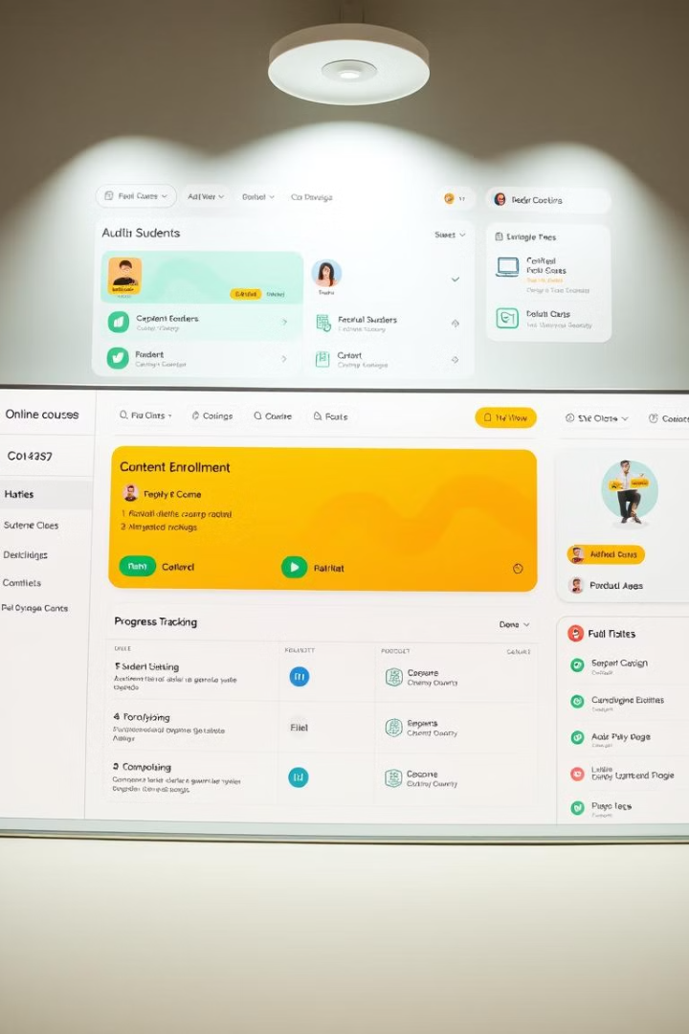
2. Course Registration & Management
1
Course Creation & Editing
Instructors create and edit courses, adding sections, lessons, and rich multimedia content.
2
Sections & Lesson Organization
Courses are structured with logical sections and lessons, providing a clear path for learners.
3
Content Upload
Instructors upload a variety of content formats, including text, images, videos, and interactive assessments.
4
Course Scheduling & Enrollment
Courses can be scheduled, allowing students to register and enroll at designated times.

Slide 4
3. Payment & Subscription
UPI Integration
Subscription & Plan Pricing Models
Payment Processing & Receipt Generation
UPI integration enables seamless and secure payment processing for Indian users.
Flexible subscription and plan pricing models cater to different user needs and budgets.
The platform handles payment processing, generating receipts for successful transactions.

Slide 5




4. Learning Management System (LMS)
Content Delivery
The LMS delivers various content formats, including quizzes, text, and videos, for interactive learning experiences.
Progression Tracking & Reporting
The platform tracks user progress through courses, providing valuable insights and reports.
Certificate Generation
Upon successful completion, users receive digital certificates acknowledging their achievements.

Slide 6
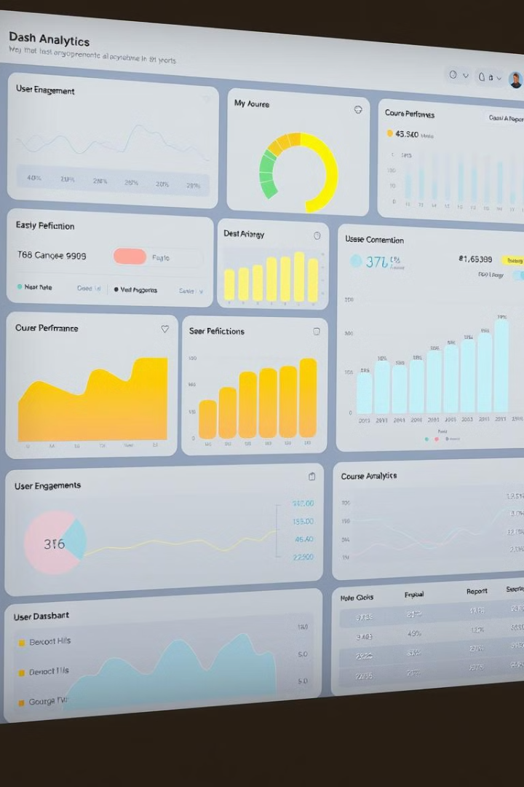
5. Analytics & Reporting
User Analytics
Tracks user engagement, activity, and progress within the platform.
Course Performance Metrics
Provides insights into course completion rates, student engagement, and overall effectiveness.
Revenue & Sales Reports
Generates reports on revenue generated, subscription models, and sales performance.

Slide 7
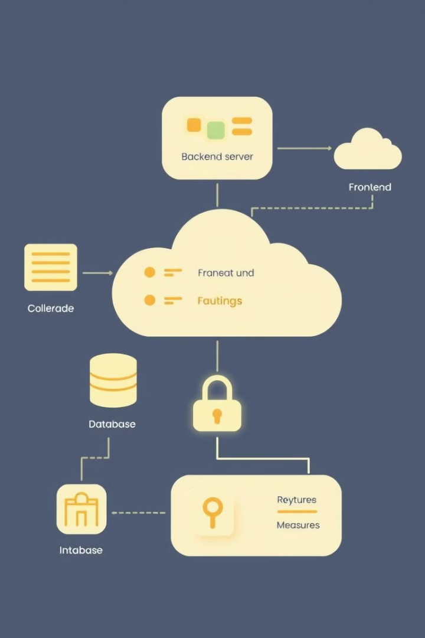




6. Technology Stack
Frontend
Backend
A user-friendly interface built with modern technologies, providing a seamless experience.
The backend handles data processing, user authentication, and communication with the database.
Cloud Infrastructure
Security Considerations
Utilizes cloud services for scalability, reliability, and secure data storage.
Comprehensive security measures are implemented to protect user data and ensure platform integrity.

Slide 8


SWOT Analysis for Online Examination Website
This SWOT analysis explores the strengths, weaknesses, opportunities, and threats associated with an online examination website that incorporates machine learning for offline-to-online exam conversion.
by vasim biradar

Slide 9

Strengths
1
Comprehensive Functionality
2
Innovative ML Integration
The platform offers a wide range of features, including question creation, exam scheduling, result analysis, and detailed reporting, catering to various educational needs.
Machine learning algorithms enhance the website's functionality by automating tasks such as question generation, plagiarism detection, and exam difficulty adjustment.
3
Scalability
4
User-Friendly Interface
The platform is designed to handle a high volume of users and exams without compromising performance, ensuring efficient and reliable operation.
The intuitive and accessible user interface provides a smooth and enjoyable experience for both test takers and administrators.

Slide 10
Weaknesses
High Development Cost
Complexity in ML Model Training
Technical Support Requirement
Developing and maintaining a sophisticated platform with advanced ML capabilities can be costly.
Training and optimizing ML models for accurate exam conversion requires significant time, resources, and expertise.
The platform may require dedicated technical support to address user issues, resolve technical glitches, and ensure smooth operation.

Slide 11





Opportunities
Growing Demand for Online Education
Global Reach
The platform can expand its reach globally, catering to diverse educational institutions and learners worldwide.
The increasing popularity of online learning creates a substantial market for efficient and reliable online examination platforms.
Partnerships with Educational Institutions
AI/ML Advancements
Continued advancements in artificial intelligence and machine learning can enhance the platform's functionality and create new opportunities.
Collaborating with universities, colleges, and other educational institutions can expand the platform's user base and market reach.

Slide 12

Threats
Competition
Existing online examination platforms and new entrants pose competition.
Data Privacy Regulations
Stringent data privacy regulations require strict compliance to ensure data security and user trust.
Technical Failures
System outages or technical malfunctions can disrupt operations and damage the platform's reputation.
Cybersecurity Risks
Data breaches and cyberattacks pose threats to user data and the platform's security.
Resistance to Change
Some individuals and institutions may be hesitant to adopt new technologies, hindering platform adoption.

Slide 13





Suggestions for Implementation
Leverage Kaggle Datasets
Utilize publicly available datasets to train and improve the accuracy of ML models for exam conversion.
Focus on User Experience
Prioritize user-friendliness, accessibility, and seamless navigation to enhance user satisfaction.
Robust Testing and Feedback Loops
Conduct rigorous testing and gather user feedback to identify areas for improvement and ensure platform reliability.
Marketing Strategy
Develop a comprehensive marketing strategy to promote the platform's features and benefits to target audiences.
Support and Training
Provide comprehensive support and training resources for both users and administrators to facilitate seamless adoption.

